Slide 1




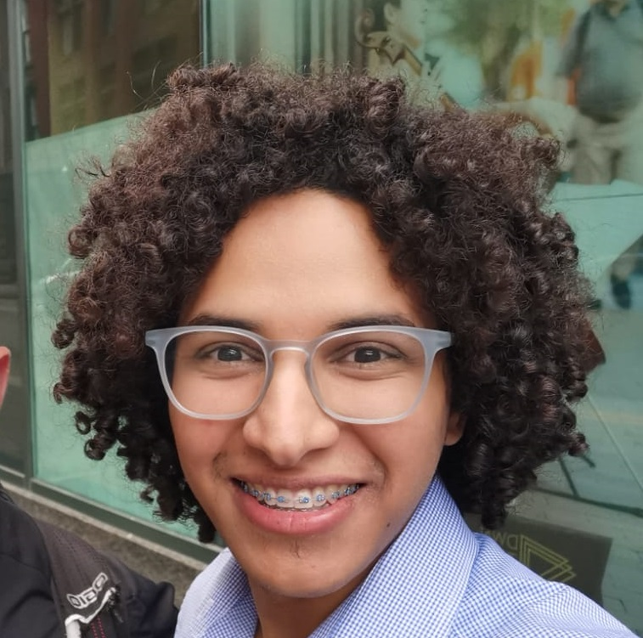
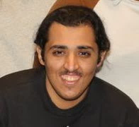
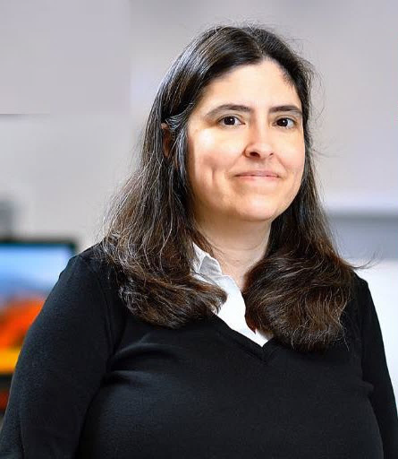
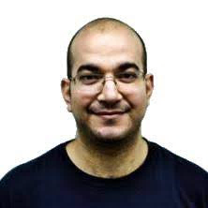

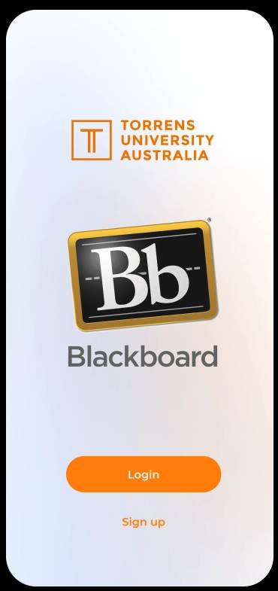
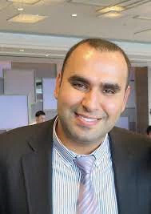


The 20th International Web for All Conference
April 30th-May 1st , 2023
The State of Accessibility in Blackboard: Survey and User Reviews Case Study
Here is where your presentation begins
Wajdi Aljedaani
Mohamed Wiem Mkaouer
Mohammed Alkahtani
Stephanie Ludi
University of North Texas
University of North Texas
University of North Texas
Rochester Institute of Technology
Marcelo M. Eler
Ali Ouni
University of Quebec
University of São Paulo

Slide 2


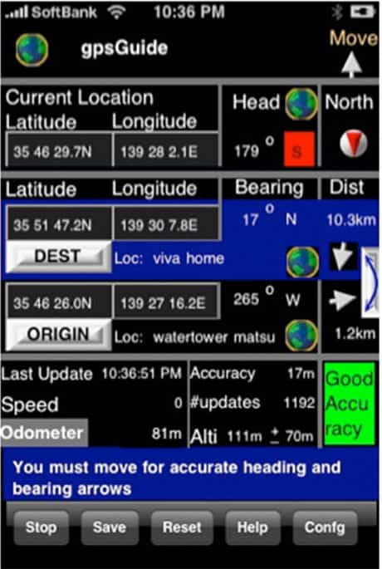

Introdcution
Many websites or mobile applications (apps) have poor accessibility which makes it difficult for people with disabilities to use them.
@
Many software developers and designers still do not incorporate accessibility into their software development process due to lack of awareness or lack of resources.
2

Slide 3
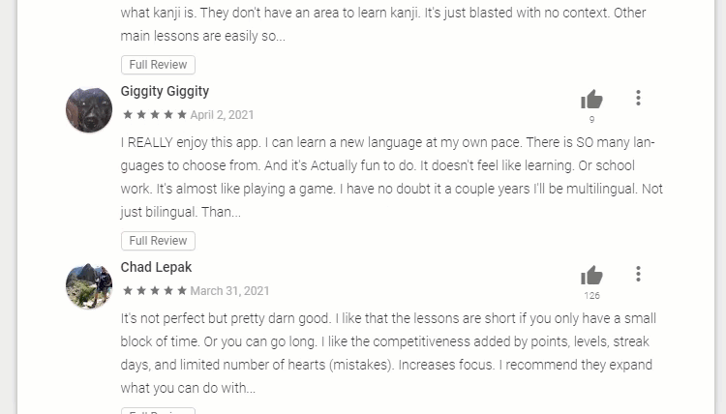
Problem Statment
“
Hard to navigate and often causes glitches in test submission. Difficult to find what you need
“
3
Notes:
When you read this review that complaining about accessibility, which is okay maybe the developers get that dairely. However, when we get the same reviews for the same topic. Thus, it is become alarming as software developers, we need to play attention because they all coming to have a similar pattern which is blackboard and accessibility. Let’s see what is he researches are doing in this topic.

Slide 4
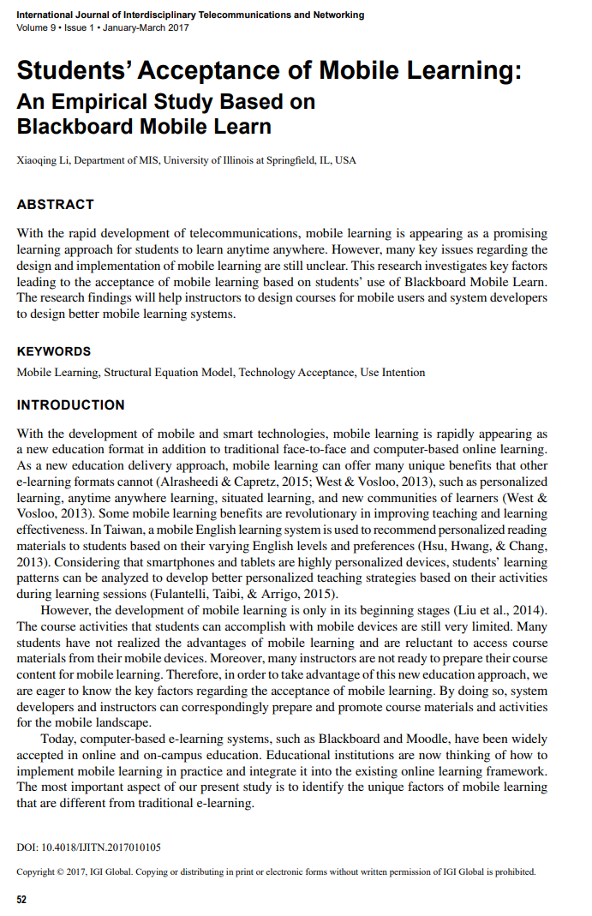
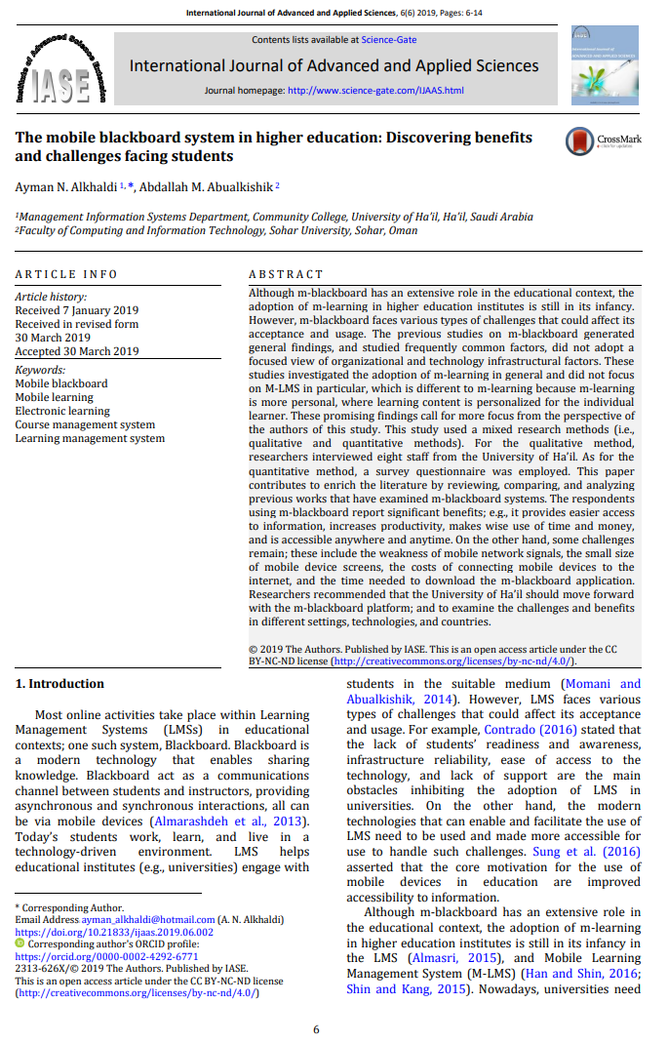
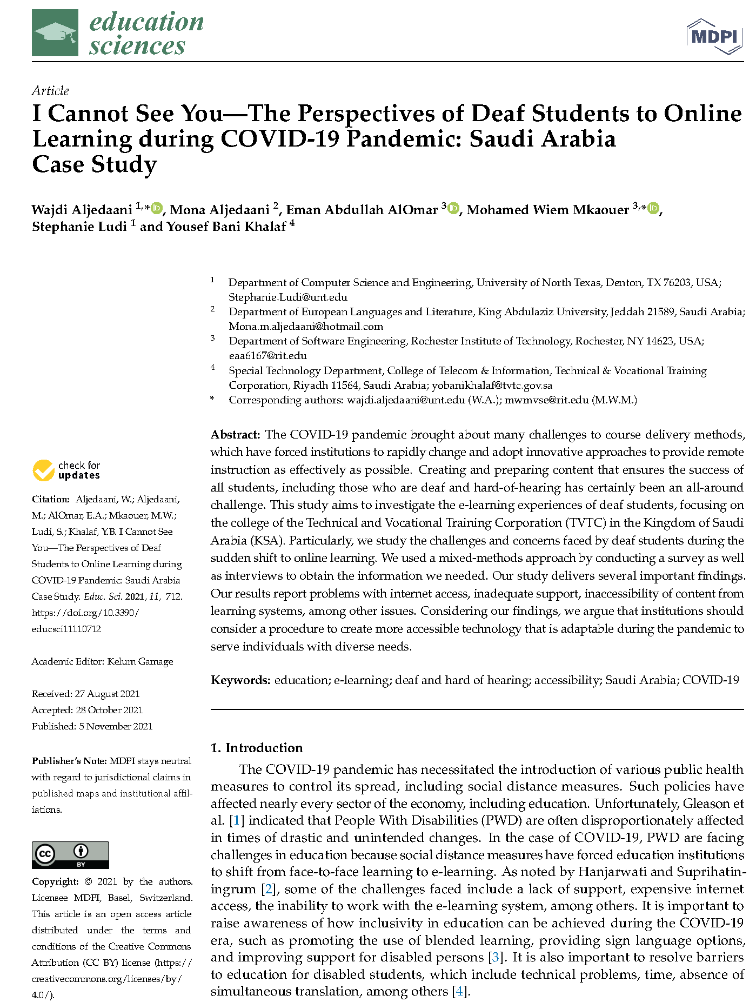
Problem Statment
1
3

Slide 5
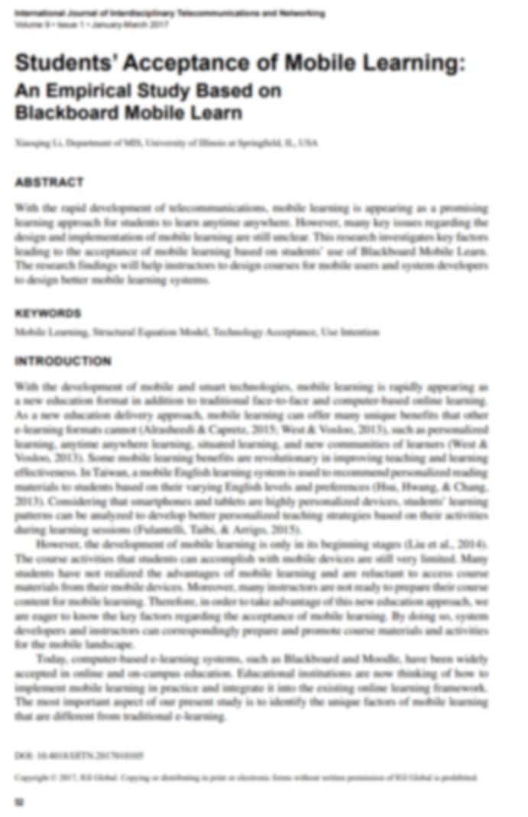
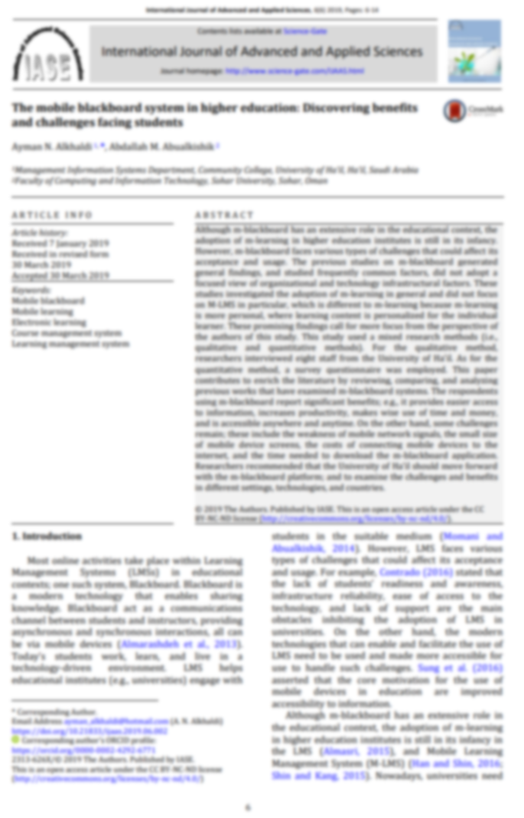

Problem Statment
1
Yet, little is known about the extent to which Blackboard successfully meets the expectations of students with disabilities because most studies focused on general usability aspects.
3

Slide 6

Study Objective
“
Our aim to investigate how accessible Blackboard LMS is from the student’s perspective by using two strategies;
Surveying students to gather their perceptions of LMS,
Analyzing the user reviews of LMS Android App.
“
4

Slide 7
Research Question
To what extent do students find the Blackboard mobile application easy-to-use?
RQ 1
What accessibility issues are reported by the users of Blackboard app?
RQ 2
5

Slide 8
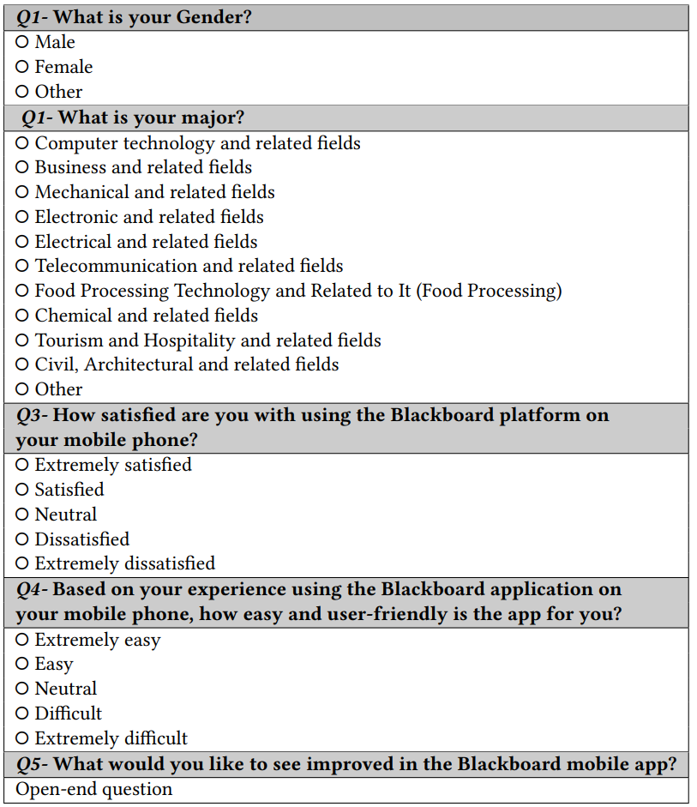
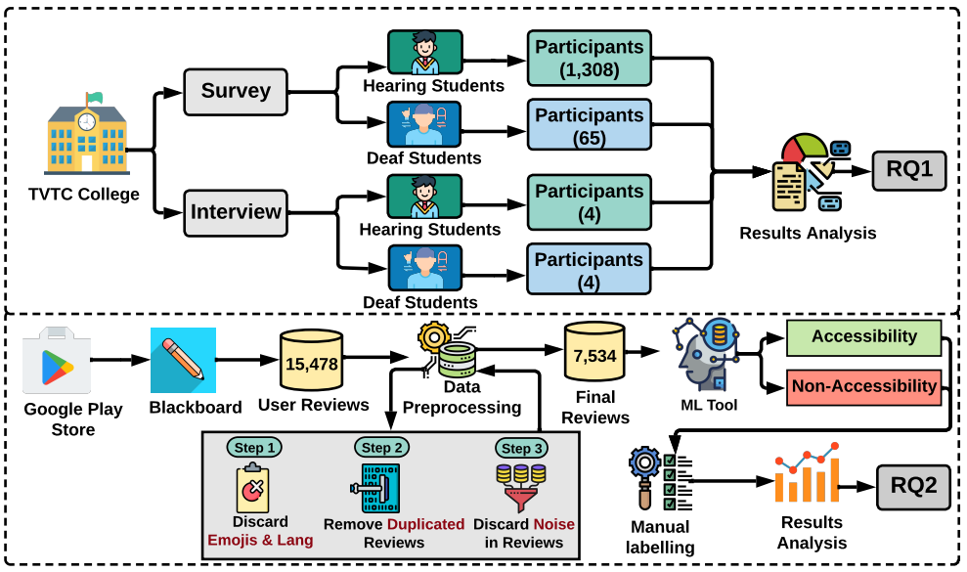
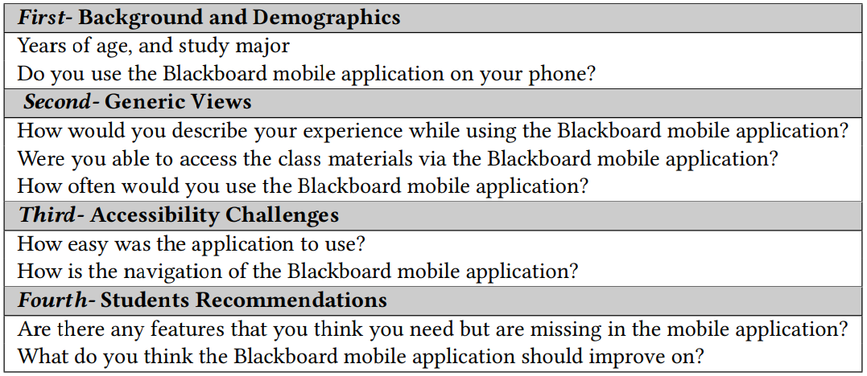
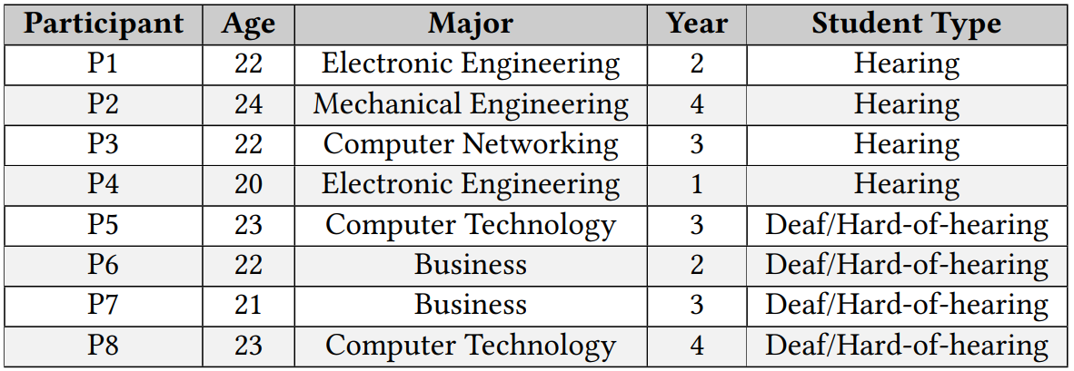
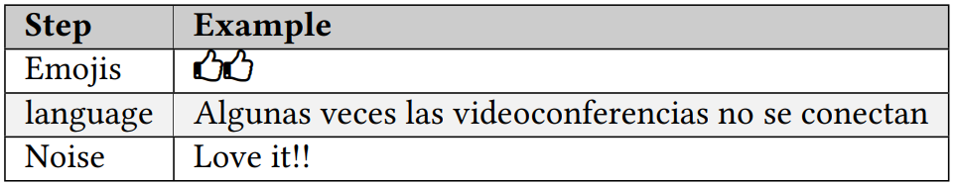
Study Approach
This is a slide structure based on a thesis defense presentation
You can delete this slide when you’re done editing the presentation
6

Slide 9
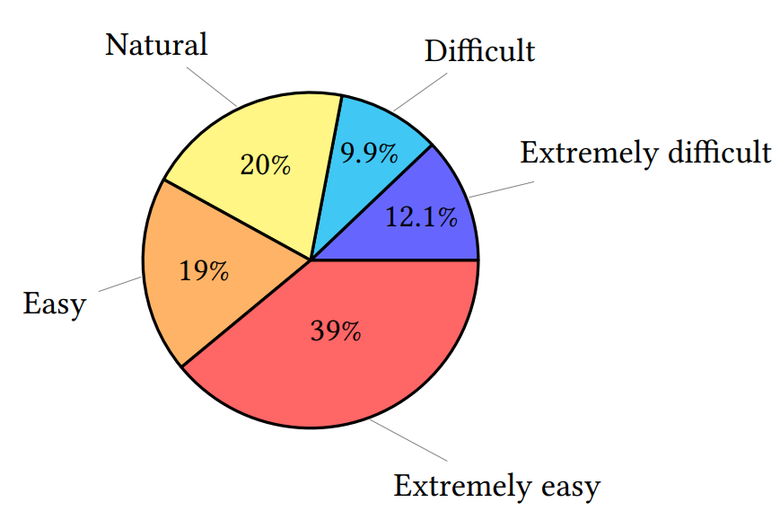
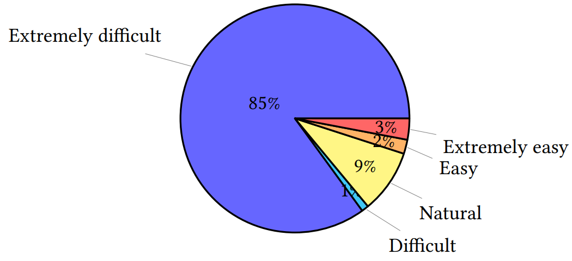
Study Results
To what extent do students find the Blackboard mobile application easy-to-use?
RQ 1
Figure 1: Percentage of the hearing students (no. 1308) participated in the survey.
Figure 2: Percentage of the deaf students (no. 65) participated in the survey.
7

Slide 10
Study Results
To what extent do students find the Blackboard mobile application easy-to-use?
RQ 1
Figure 2: Percentage of the deaf students (no. 65)
Figure 1: Percentage of the hearing students (no. 1308)
1
“I usually like education apps so that it can be more convenient to learn from my phone. However, I Can’t watch videos or download files in the blackboard app. Then, I stopped using the app and switched to the web version.” (P8)
3
“I liked the app, and it was easy to use. My issue always was in the exam where the picture is not shown in the exams, and I missed a few questions for that reason.” (P7)
2
4
“Because I am deaf and rely on visualization, I cannot have the video caption in the app for videos.” (P5)
“I love the app, and I used to study my class materials on it. Sometimes links in the app are not working, and the show me page was not found.” (P3)
8

Slide 11
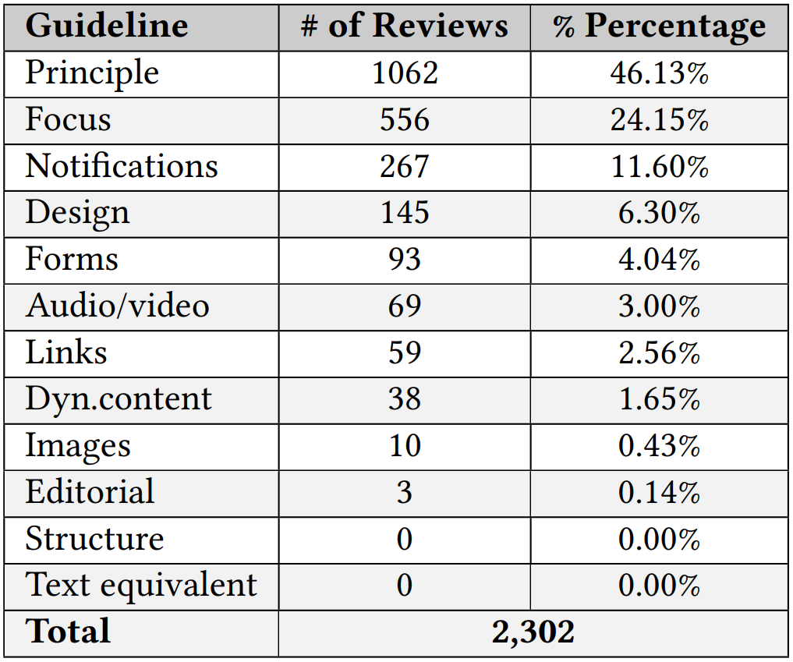
Study Results
What accessibility issues are reported by the users of Blackboard app?
RQ 2
“Fix the goddamn notifications I missed requirements because of this!”
1
“It works, but what’s with the zany button click animations, etc? They’re really distracting, I’d like to see them toned down a good bit.”
2
“For a student who is Blind that uses accessibility software, JAWS, a screen reader that the Blind uses to operate on a computer, the Blackboard application does not function correctly when jaws require that some activation requires the user to do a double tap to activate some functions of radio dialogues, especially when taking an exam to open the test and when navigating to the next test question the application did not move to the next question but went and submitted the exam test.no be.”
3
9

Slide 12
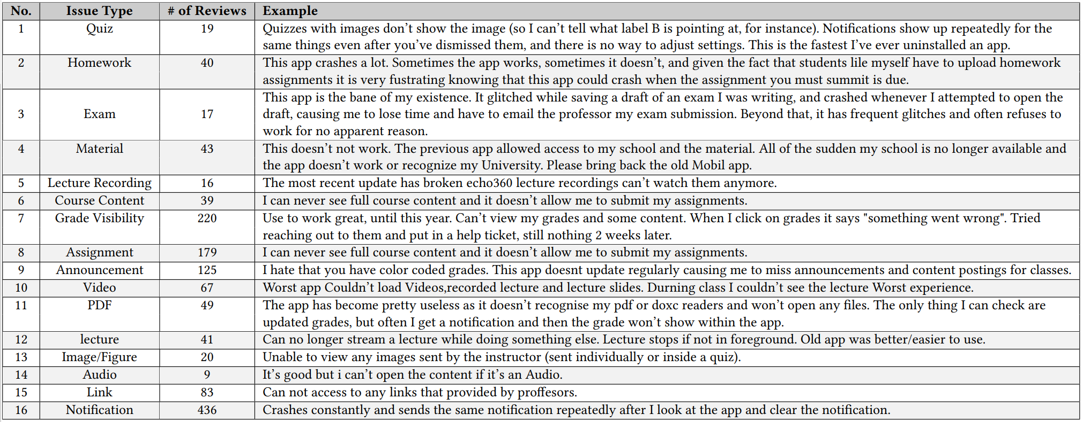
Study Results
What accessibility issues are reported by the users of Blackboard app?
RQ 2
10

Slide 13
Study Takeaways
1
3
Both deaf and hearing students frequently rely on videos that have been uploaded on Blackboard to learn the contents of a course.
Students should be able to efficiently and effectively utilize the app, attend lessons, take assignments, and even download materials.
“Students should be able to easily access and download videos and material for later and further studies.”
“Some of the responsibility lies in the content creator. In that sense, the LMS should have a policy to enforce alternative formats to study materials made available to students.”
2
4
Lack of captions in videos: some of the videos did not have captions according to students, making it challenging for deaf students to perceive and understand the content.
Blackboard application lacked certain application guidelines that are required for a better user experience for students with disabilities and those without disabilities.
“We classified those guidelines to identify the corresponding issue more precisely in terms of principles, focus, notifications, and design.”
“LMS should have a policy to enforce uploaded videos to be properly captioned.”
11

Slide 14


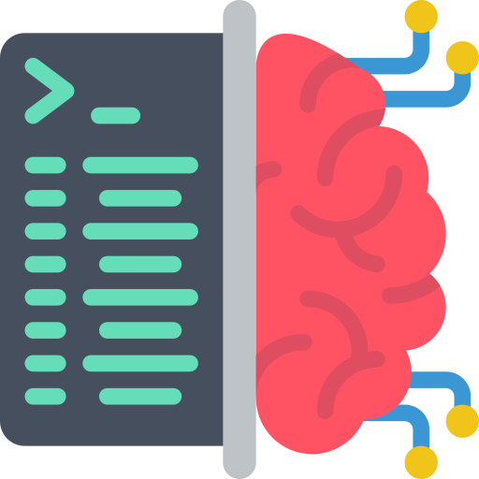

Threats to Validity
Sample Bias
User Reviews Labeling
Detecting accessibility user reviews
1,308 Hearing students
65 Deaf & Hard of Hearing students
ML Binary Classification
Two Authors labeling
Inter-rater Agreement Level 0.87 Perfect Agreement
Manually read
2,302 reviews
Three-Step Iterations
12
Notes:
three-step iterations
Two authors labeled them separately
inter-rater agreement level using Cohen’s Kappa Coefficient 0.87 perfect agreement

Slide 15
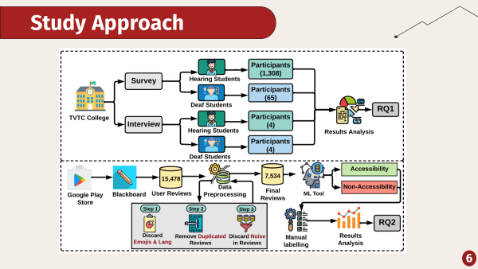
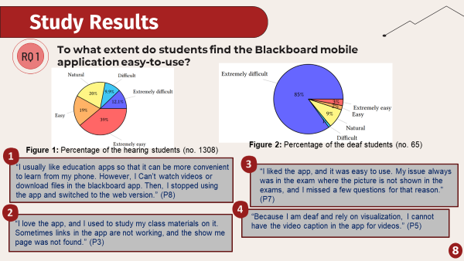
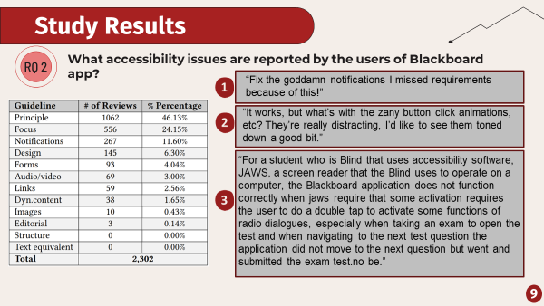
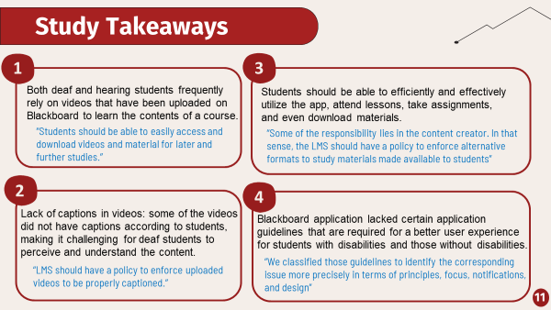
Conclusion
13
Notes:
Conclusion

Slide 16
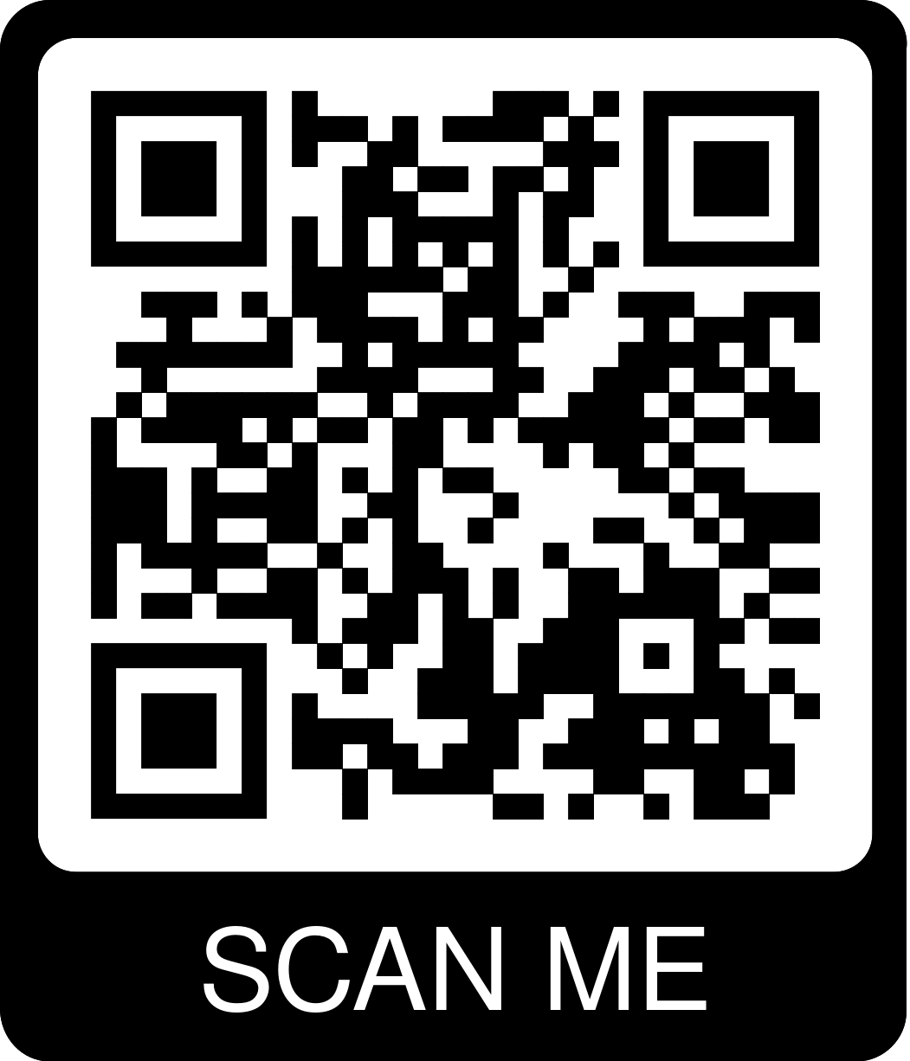
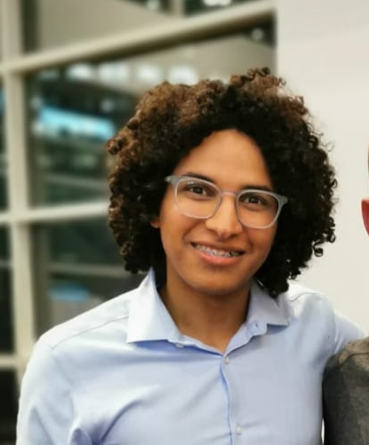

Dr. Wajdi Aljedaani
Thank you for listening!
Do you have any questions?
wajdi-aljedaani
Notes:
Conclusion

